Slide 1



Slide 2



01CE0503 - Design and Analysis of Algorithm
Unit - 7
Backtracking and Branch and Bound
Prof. Jaydeep K. Ratanpara
Computer Engineering Department

Slide 3



OUTLINE
Introduction
The Eight queens problem
Knapsack problem
Travelling Salesman problem
Minimax principle.

Slide 4
INTRODUCTION
Backtracking
Backtracking is an intelligent way of gradually building the solution.
Typically, it is applied to constraint satisfaction problems like 8-queen puzzles, chess, crossword, and many other games.
Dynamic programming and greedy algorithms are optimization techniques, whereas backtracking is s general problem-solving method.
It does not guarantee an optimal solution.
A solution to many problems can be viewed as the making of a sequence of decisions. For example, TSP can be solved by making the sequence of the decision of which city should be visited next.

Slide 5
INTRODUCTION
Backtracking
Backtracking builds the solution incrementally. Partial solutions that do not satisfy the constraints are abandoned.
Backtracking algorithms are used when we have a set of choices, and we don’t know which choice will lead to the correct solution. The algorithm generates all partial candidates that may generate a complete solution.
Backtracking systematically searches the set of all feasible solutions, called solution space, to solve the given problem.
Each choice leads to a new set of partial solutions. Partial solutions are explored in DFS (Depth First Search) order.
If a partial solution satisfies a certain bounding function, then the partial solution is explored in depth-first order.

Slide 6
INTRODUCTION
Backtracking
If the partial solution does not satisfy the constraint, it will not be explored further. The algorithm backtracks from that point and explores the next possible candidate.
Such processing is convenient to represent using a state space tree. In a state space tree, the root represents the initial state before the search begins.

Slide 7
Knapsack Problem Using Branch and Bound
Problem : Given a set of items, each having different weight and value or profit associated with it. Find the set of items such that the total weight is less than or equal to a capacity of the knapsack and the total value earned is as large as possible.
To solve this problem, A maximization problem can be converted to a minimization problem by negating the value of the objective function.
We will solve this problem with Least Cost Branch and Bound.

Slide 8
Knapsack Problem Using Branch and Bound
Steps :
Derive state space tree.
Compute Cost (c) and upper bound u for each node in state space tree.
If cost is greater than upper bound than kill that node.
Else select node with minimum cost as E-node.
Repeat step 3 and 4 until all nodes are examined.
The node with minimum cost value is the answer node. Trace the path from leaf to root in the backward direction to find the solution tuple.

Slide 9
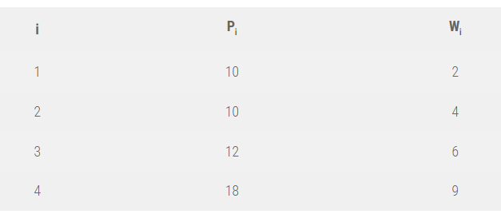
Knapsack Problem Using Branch and Bound
Solve the following instance of knapsack using LCBB for knapsack capacity M = 15.

Slide 10
Knapsack Problem Using Branch and Bound
Consider the problem with n =4, P = {10, 10, 12, 18}, w = {2, 4, 6, 9} and M= 15.
Here, we calculate the initial upper bound to be U = 10 + 10 + 12 = 32.
Note that the 4th object cannot be included here, since that would exceed W.
For the cost, we add 3/9th of the final value, and hence the cost function is 38. Remember to negate the values after calculation before comparison.
Upper bound is calculated as :
n
∑ pixi <= M
i=1
Cost is calculated as :
n
∑ pixi <= M (with fraction)
i=1

Slide 11
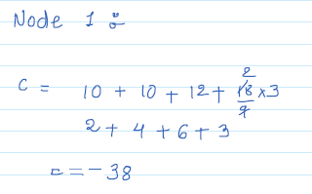
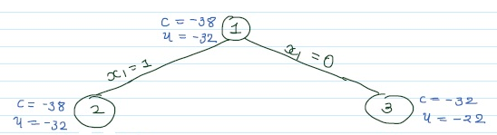

Knapsack Problem Using Branch and Bound
Solution:
Let us compute u(1) and c(1). If we include first three item then sum​(wi)​<=M
but if we include 4th item, it exceeds knapsack capacity.

Slide 12
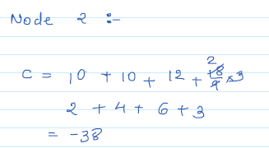
Knapsack Problem Using Branch and Bound

Slide 13
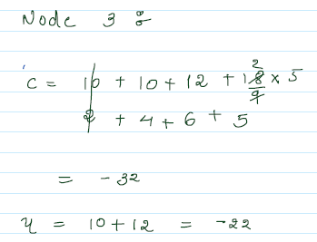
Knapsack Problem Using Branch and Bound

Slide 14
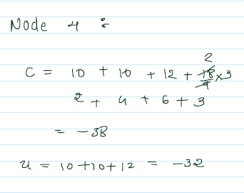
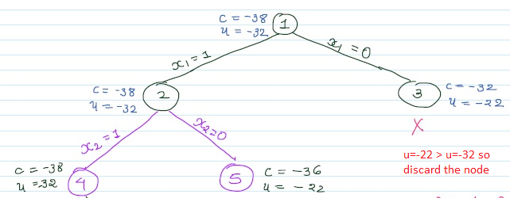
Knapsack Problem Using Branch and Bound

Slide 15
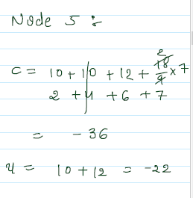
Knapsack Problem Using Branch and Bound

Slide 16
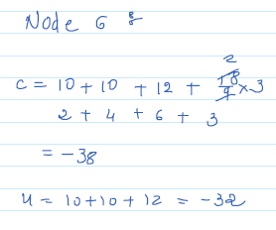
Knapsack Problem Using Branch and Bound

Slide 17
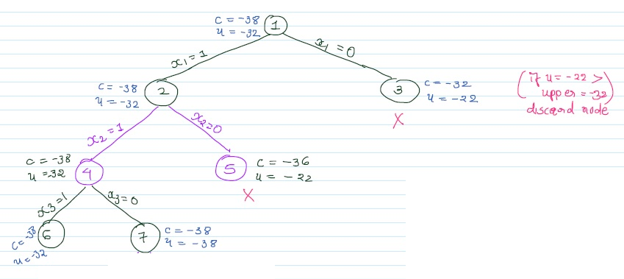
Knapsack Problem Using Branch and Bound

Slide 18
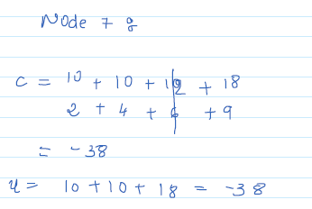
Knapsack Problem Using Branch and Bound

Slide 19
Knapsack Problem Using Branch and Bound

Slide 20
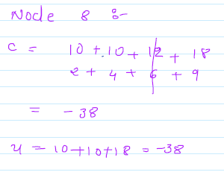
Knapsack Problem Using Branch and Bound

Slide 21
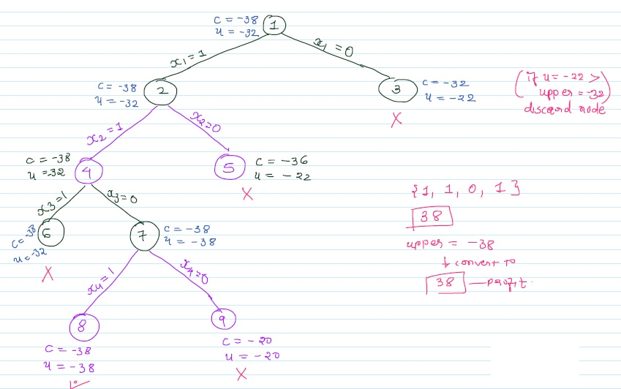
Knapsack Problem Using Branch and Bound

Slide 22
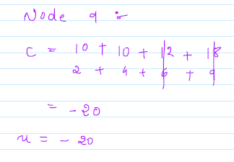
Knapsack Problem Using Branch and Bound

Slide 23
Knapsack Problem Using Branch and Bound

Slide 24
Knapsack Problem Using Branch and Bound
Note here that node 3 and node 5 have been killed after updating U at node 7.
Also, node 6 is not explored further, since adding any more weight exceeds the threshold.
At the end, only nodes 6 and 8 remain.
Since the value of U is less for node 8, we select this node.
Hence the solution is {1, 1, 0, 1}, and we can see here that the total weight is exactly equal to the threshold value in this case.

Slide 25
Travelling Salesman Problem
Problem is defined as “given n cities and distance between each pair of cities, find out the path which visits each city exactly once and come back to starting city, with the constraint of minimizing the travelling distance.”
TSP has many practical applications.
It is used in network design, and transportation route design.
The objective is to minimize the distance. We can start tour from any random city and visit other cities in any order.
With n cities, n! different permutations are possible.
Exploring all paths using brute force attacks may not be useful in real life applications.

Slide 26
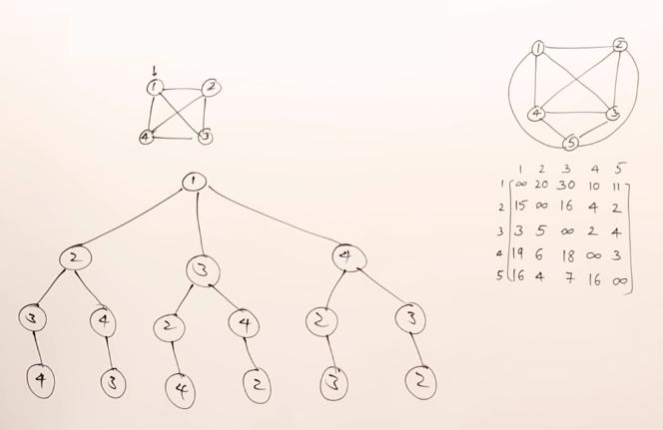
Travelling Salesman Problem

Slide 27
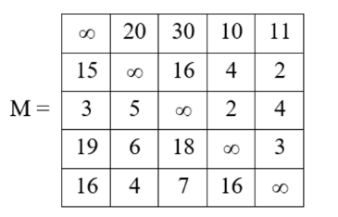
Travelling Salesman Problem
Example: Find the solution of following travelling salesman problem using branch and bound method.

Slide 28
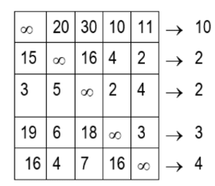
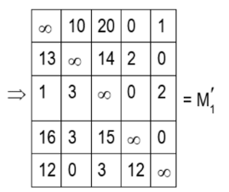
Travelling Salesman Problem
Solution : Row Reduction : Reduce above cost matrix by subtracting minimum value from each row

Slide 29
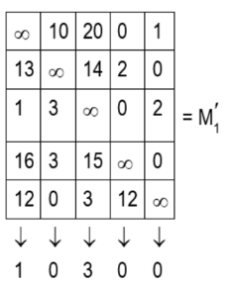
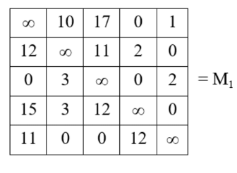
Travelling Salesman Problem
Solution : Column Reduction : Reduce above cost matrix by subtracting minimum value from each column

Slide 30
Travelling Salesman Problem
Total Reduction :
Cost of M1 = C(1) = Row reduction cost + Column reduction cost
= (10 + 2 + 2 + 3 + 4) + (1 + 3)
= 25
This means all tours in graph has length at least 25. This is the optimal cost of the path.

Slide 31
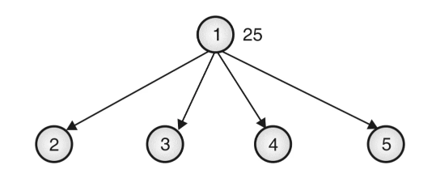
Travelling Salesman Problem
Create State space tree and find cost of edge from node 1 to 2, 3, 4, 5.

Slide 32
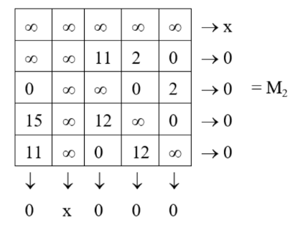
Travelling Salesman Problem
Select edge 1-2:
Set M1 [1] [ ] = M1 [ ] [2] = ∞
Set M1 [2] [1] = ∞
Reduce the resultant matrix if required.
M2 is already reduced.
So no reduction is required.
Cost of node 2 :
C(2) = C(1) + Reduction cost + M₁ [1] [2]
= 25 + 0 + 10
= 35

Slide 33
Travelling Salesman Problem
Select edge 1-3:
Set M1 [1][ ] = M1 [ ] [3] = ∞
Set M1 [3][1] = ∞
Reduce the resultant matrix if required.

Slide 34
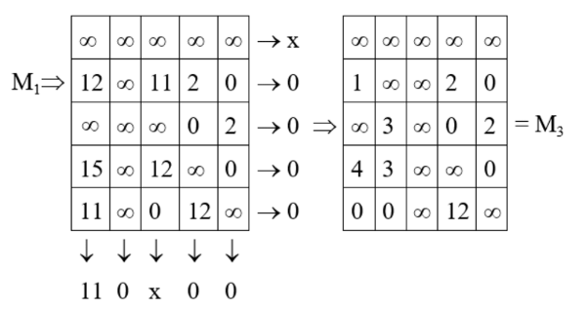
Travelling Salesman Problem
Cost of node 3:
C(3) = C(1) + Reduction cost + M1[1] [3]
= 25 + 11 + 17
= 53

Slide 35
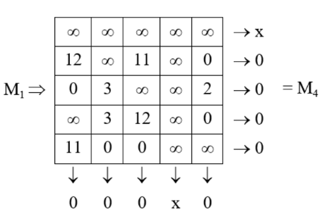
Travelling Salesman Problem
Select edge 1-4:
Set M1 [1][ ] = M1[ ][4] = ∞
Set M1 [4][1] = ∞
Reduce resultant matrix if required.
Matrix M4 is already reduced.
Cost of node 4:
C(4) = C(1) + Reduction cost + M1 [1] [4]
= 25 + 0 + 0 = 25

Slide 36
Travelling Salesman Problem
Select edge 1-5:
Set M1 [1] [ ] = M1 [ ] [5] = ∞,
Set M1 [5] [1] = ∞
Reduce the resultant matrix if required.

Slide 37
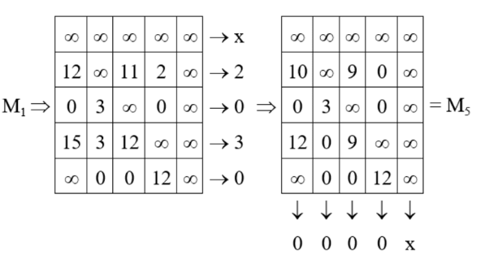
Travelling Salesman Problem
Cost of node 5:
C(5) = C(1) + reduction cost + M₁ [1] [5]
= 25 + 5 + 1
= 31

Slide 38
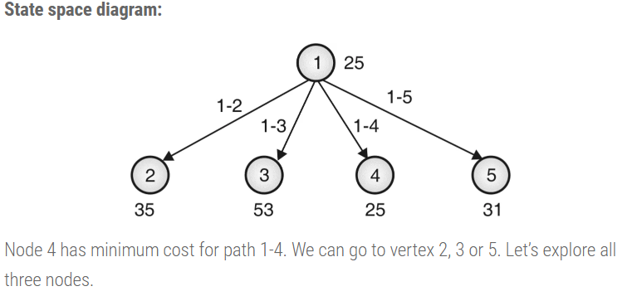
Travelling Salesman Problem

Slide 39
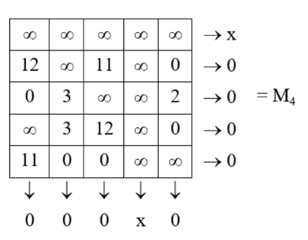
Travelling Salesman Problem
Select edge 1-4-2 (Add edge 4-2):
Set M4 [1] [] = M4 [4] [] = M4 [] [2] = ∞
Set M4 [2] [1] = ∞
Reduce resultant matrix if required.
Matrix M4 is already reduced.

Slide 40
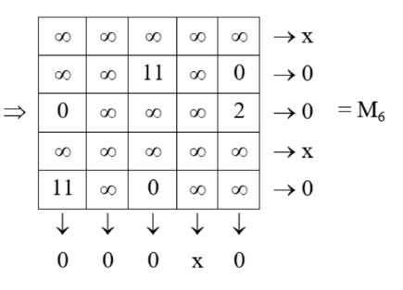
Travelling Salesman Problem
Select edge 1-4-2 (Add edge 4-2):
Cost of node 6: C(6) = C(4) + Reduction cost + M4 [4] [2]
= 25 + 0 + 3 = 28

Slide 41
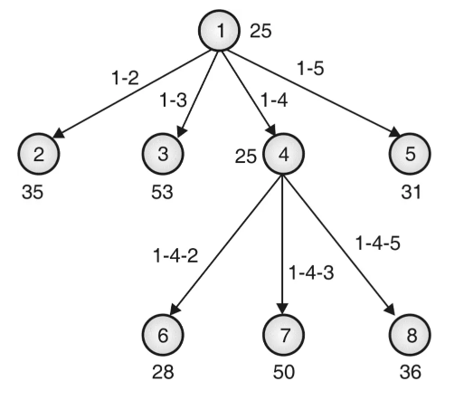
Travelling Salesman Problem

Slide 42
Travelling Salesman Problem
Add edge 2-3 (Path 1-4-2-3):
Set M6 [1][ ] = M6 [4][ ] = M6 [2][ ] = M6 [ ][3] = ∞
Set M6 [3][1] = ∞
Reduce resultant matrix if required.

Slide 43
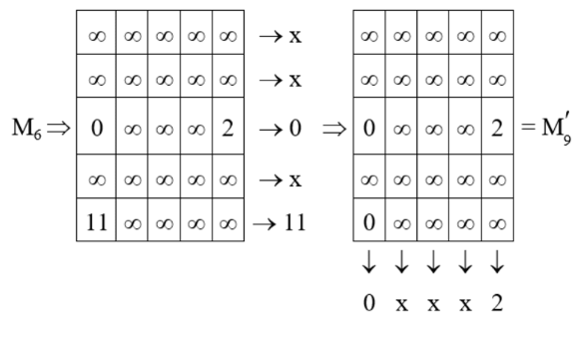
Travelling Salesman Problem

Slide 44
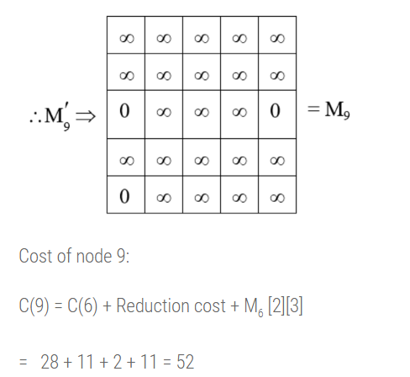
Travelling Salesman Problem

Slide 45
Travelling Salesman Problem
Add edge 2-5 (Path 1-4-2-5):
Set M6 [1][ ] = M6 [4][ ] = M6 [2][ ] = M6 [ ][5] = ∞
Set M6 [5][1] = ∞
Reduce resultant matrix if required.

Slide 46
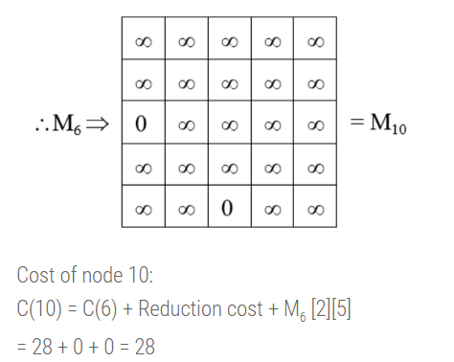
Travelling Salesman Problem

Slide 47
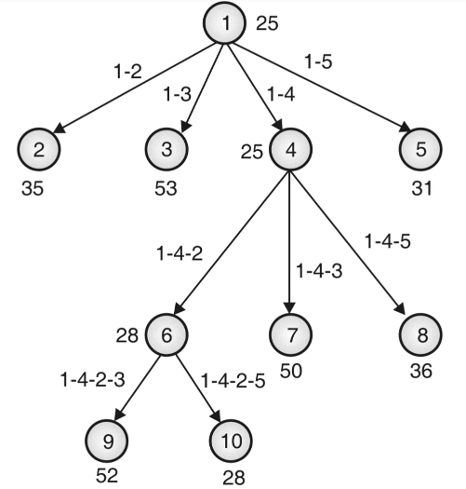
Travelling Salesman Problem

Slide 48
Travelling Salesman Problem
Add edge 5-3 (Path 1-4-2-5-3):
Set M6 [1][ ] = M6 [4][ ] = M6 [2][ ] = M6 [ ][5] = ∞
Set M6 [5][1] = ∞
Reduce resultant matrix if required.

Slide 49
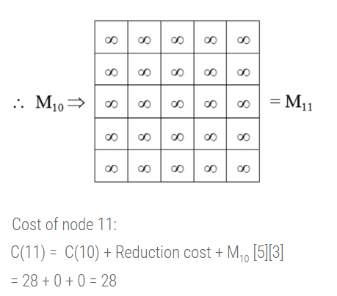
Travelling Salesman Problem

Slide 50
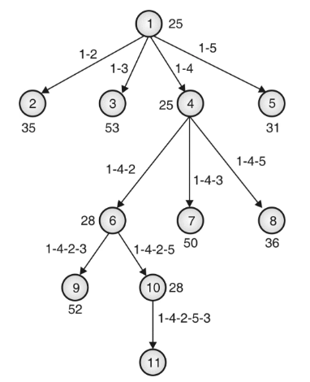
Travelling Salesman Problem

